Slide 1
ONLINE GROCERY ORDERING SYSTEM
GROUP NO :- G 21
Jawale Saurabh (219079)
Gurav Ashish (219032)

Slide 2
ABSTRACT
This project is aimed at developing a Web application that depicts online Shopping of grocery products. It integrates the benefits of an ordering products with the convenience of an online excitement and going with the technology, minus the commuting hazards and expenses. It will usher in the immense flexibility and sophistication in the existing manual platform structures, with the perfect blend of synchronous and asynchronous interaction. It provides a means of collaborative E-ordering for the customers.

Slide 3
INTRODUCTION
This project is a web-based shopping system for an existing shop. The "Online Grocery Ordering System" has been developed to override the problems prevailing in the practicing manual system.
It can assist the business to concentrate on their other activities rather concentrate on the record-keeping by managing the information of Customers, Grocery, Orders, Addresses, Products. It will also help the business to reach a large number of customers.

Slide 4
MODULES
Customer Modules
View Product
Add to Cart
Place Order
View Order

Slide 5
MODULES
Administrative Modules
Manage products
Manage Orders
Manage Customers

Slide 6
Scope & Purpose
Purpose :
To manage the online grocery product ordering. It helps to customer to book products from anywhere. Also make payment on delivery. It helps to people to book desired products at their prefer time.

Slide 7
Scope :
Online Grocery Shop is a platform for a grocery shop to enhance their sale. In this application the customer can login, select products, quantity and proceed towards confirm order. After confirming the order grocery provider will get a notification of order. Payment method will be cash on delivery. This website will give the grocery shop a greater exposure to their products.

Slide 8
PROPOSED SYSTEM
The Proposed system ensures the complete freedom for users, where user at his/her own system can logon to this website and can order his/her product. Our proposed system allows only registered users to order the product, view order and cancel their order as per their need.

Slide 9
WEB PAGES
Home Page
Login Page
Register Page
Customer Page
Cart Page
Order Page
Profile Page
About and Contact us Page
Shopkeeper page
Order details Page
Order History Page
Products Page
All Customers List page

Slide 10
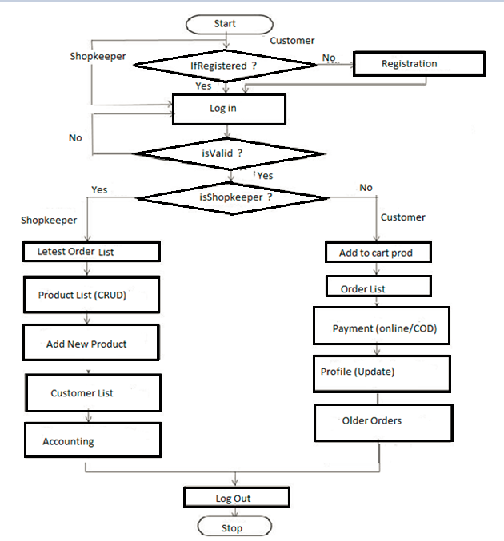
ACTIVITY DIAGRAM

Slide 11
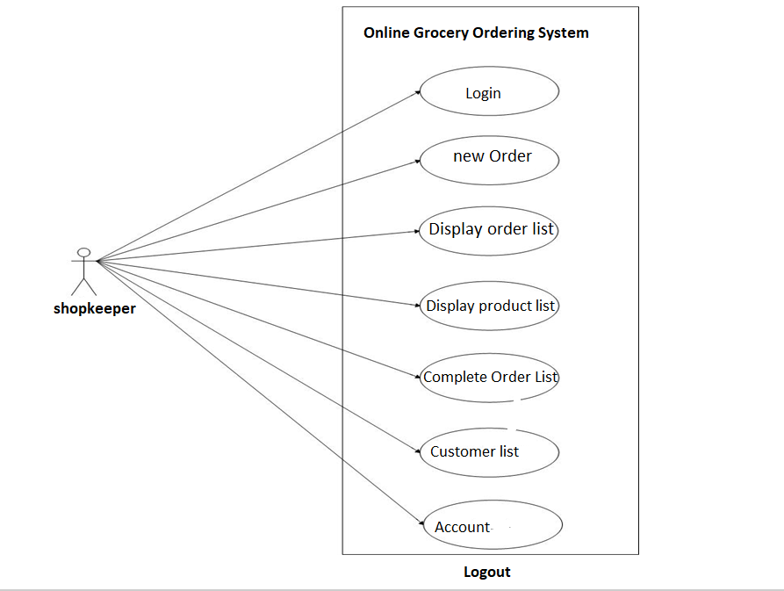
USE CASE DIAGRAM
Use Case Diagram for Shopkeeper

Slide 12
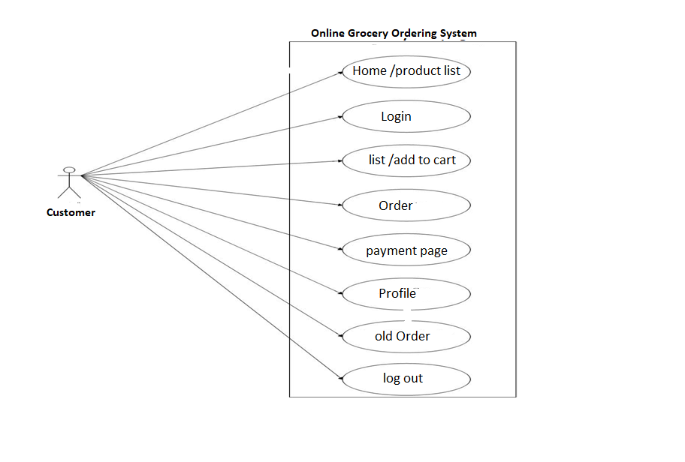
USE CASE DIAGRAM
Use Case Diagram for Customer

Slide 13
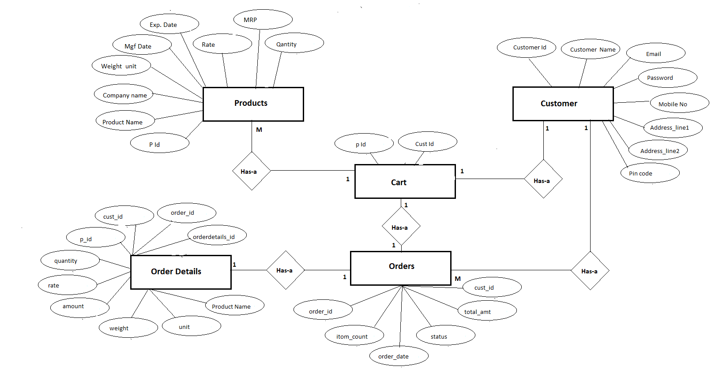
E-R DIAGRAM

Slide 14
CONCLUSION
The rapid growth of products and brands, people have speculated that online shopping will overtake in-store shopping.
The availability of online shopping has produced a more educated consumer that can shop around with relative ease without having to spend a large amount of time.
Online shopping has opened up doors to many small retailers that would never be in business if they had to incur the high cost of owning a brick and mortar store. At the end, it has been a win-win situation for both consumer and sellers.

Slide 15
FUTURE SCOPE
Payment gateway is in our future scope we are going to provide many options for payment. We will permit multiple payment modes that include UPI, cash on delivery, card on delivery, net banking, EMIs on credit or debit card and pay-later credit facility.
The customer experience has become a main focus for ecommerce. So order tracking also we are going to add in our project. Order tracking allows you to monitor all of your online orders and shipments. This thing will play key role in customer experience.

Slide 16
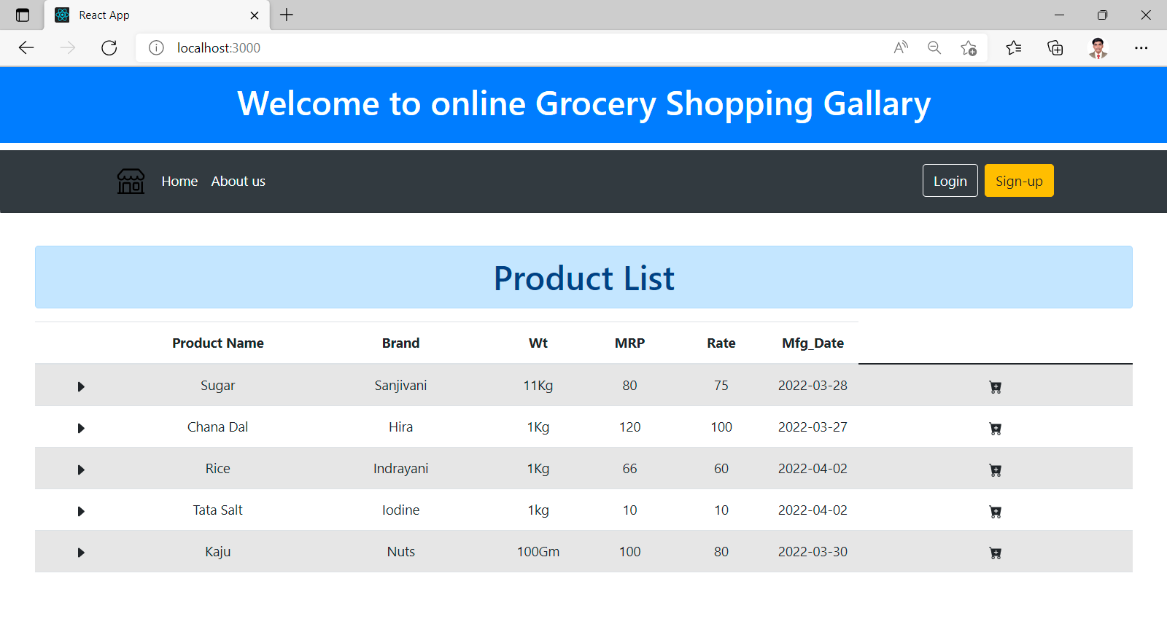
1. Home page

Slide 17
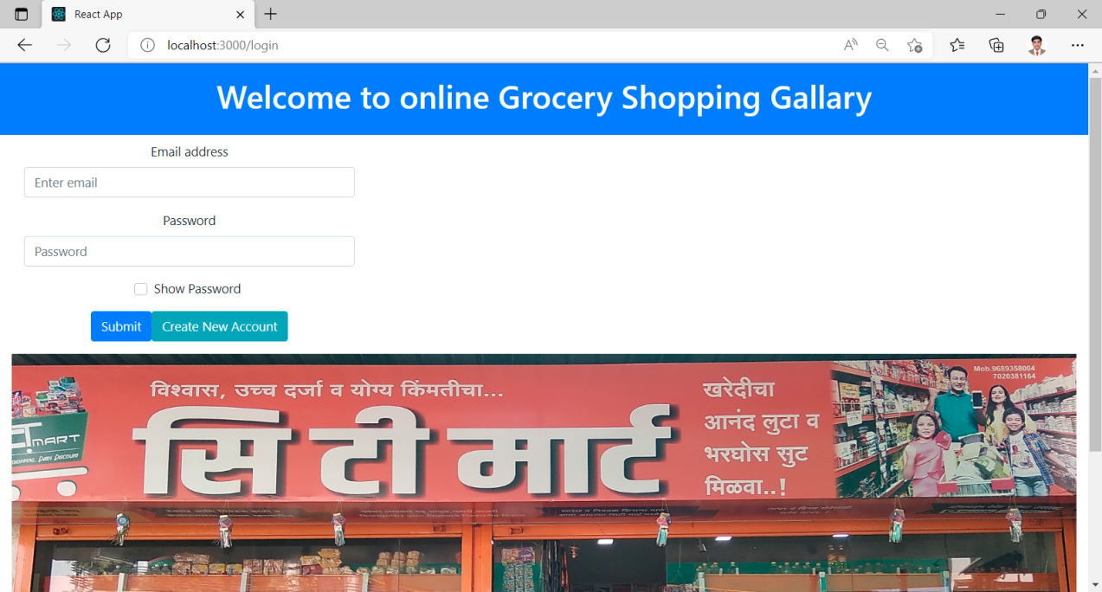
2. Login Page

Slide 18
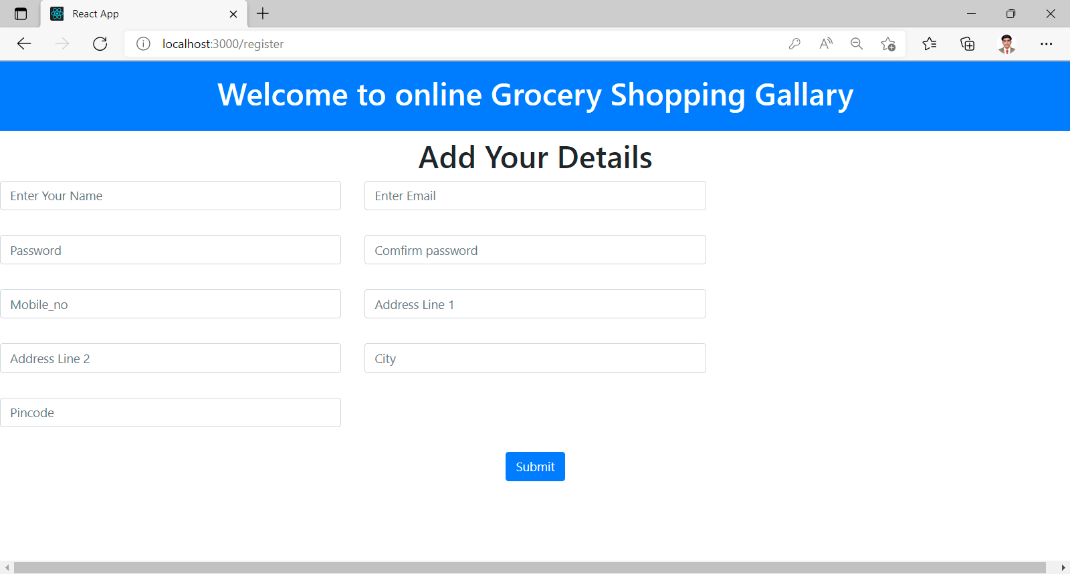
3. Registration Page

Slide 19
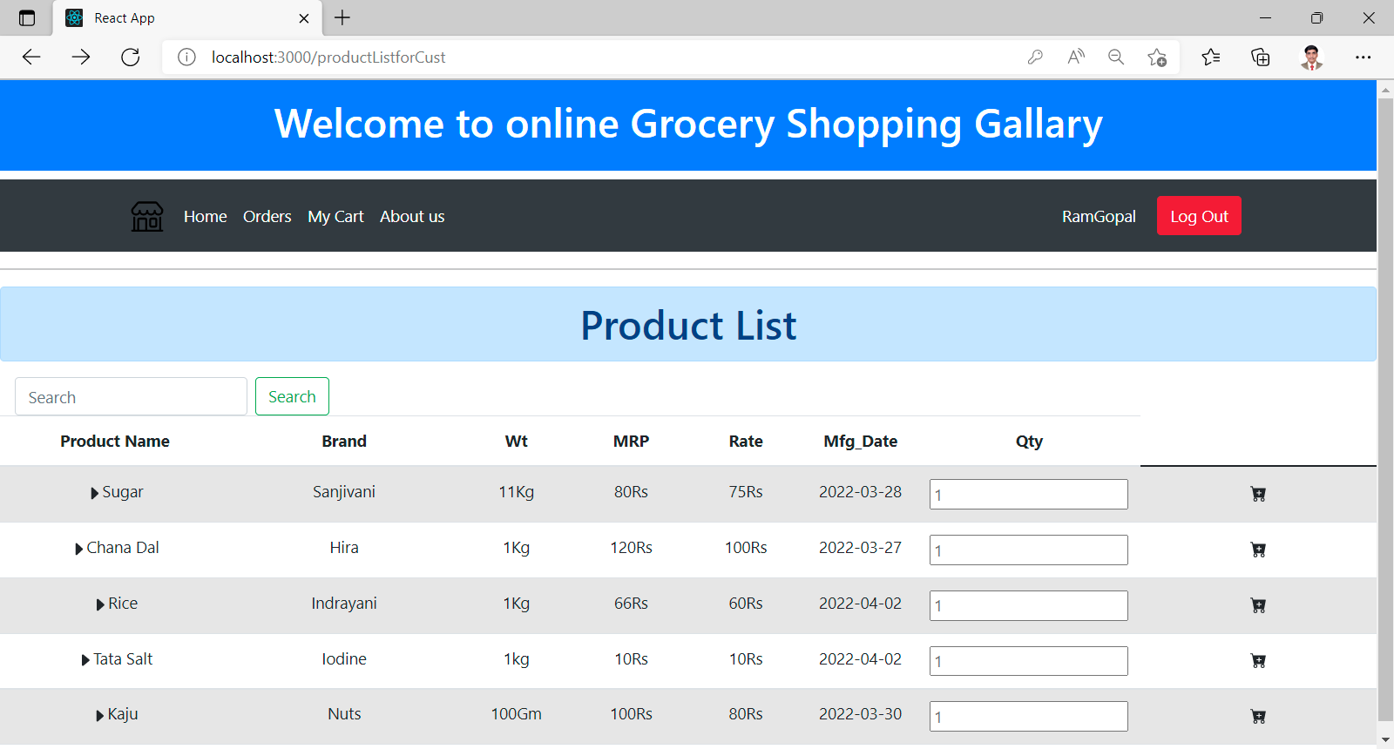
4. Customer Page (RamGopal is a customer)

Slide 20
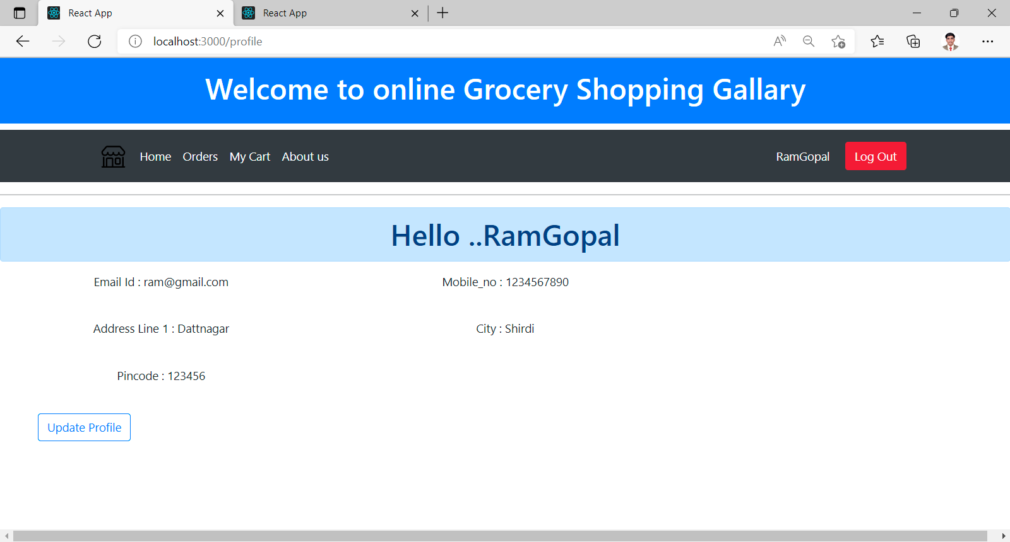
5. Customer View Our Profile On click Our name

Slide 21
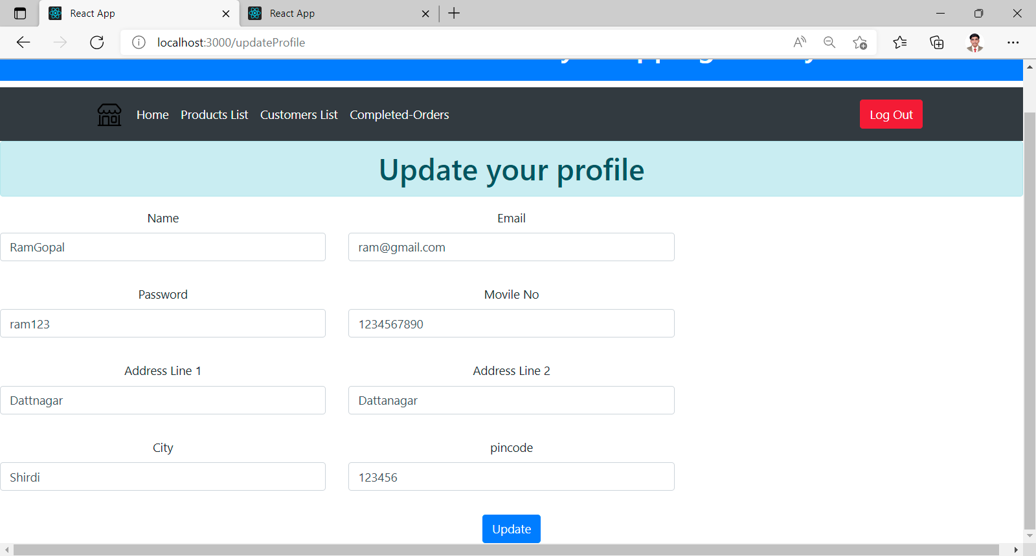
6. On click update button customer update our profile

Slide 22
7. Customer Home Page Select Product and add in cart

Slide 23
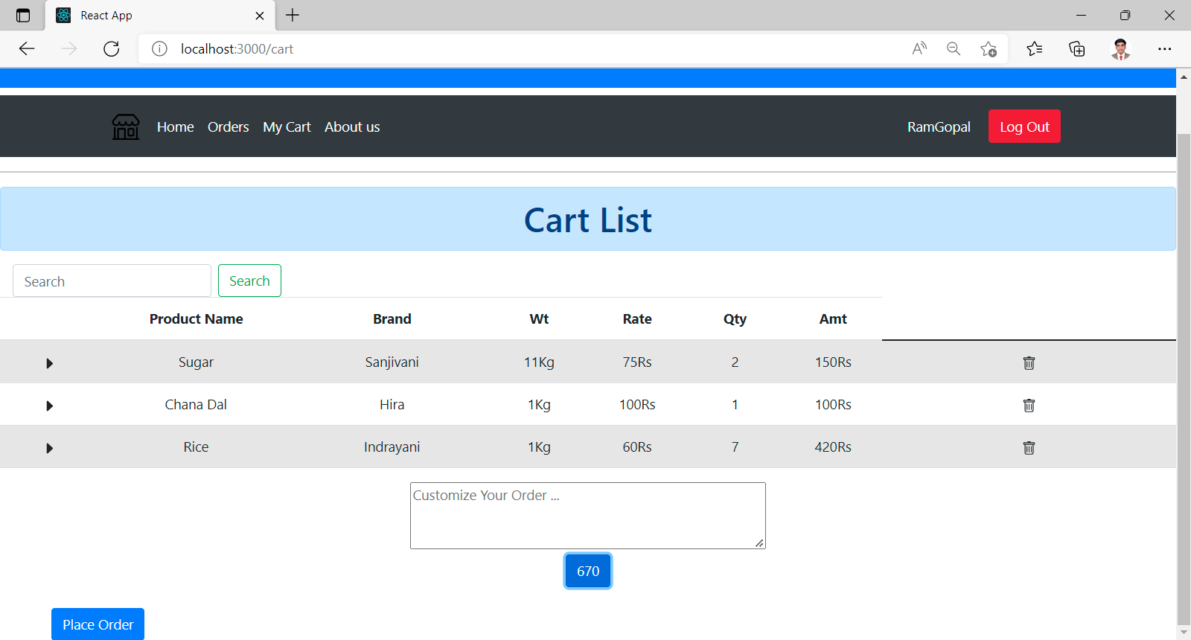
8. After adding product go to My cart and place Order

Slide 24
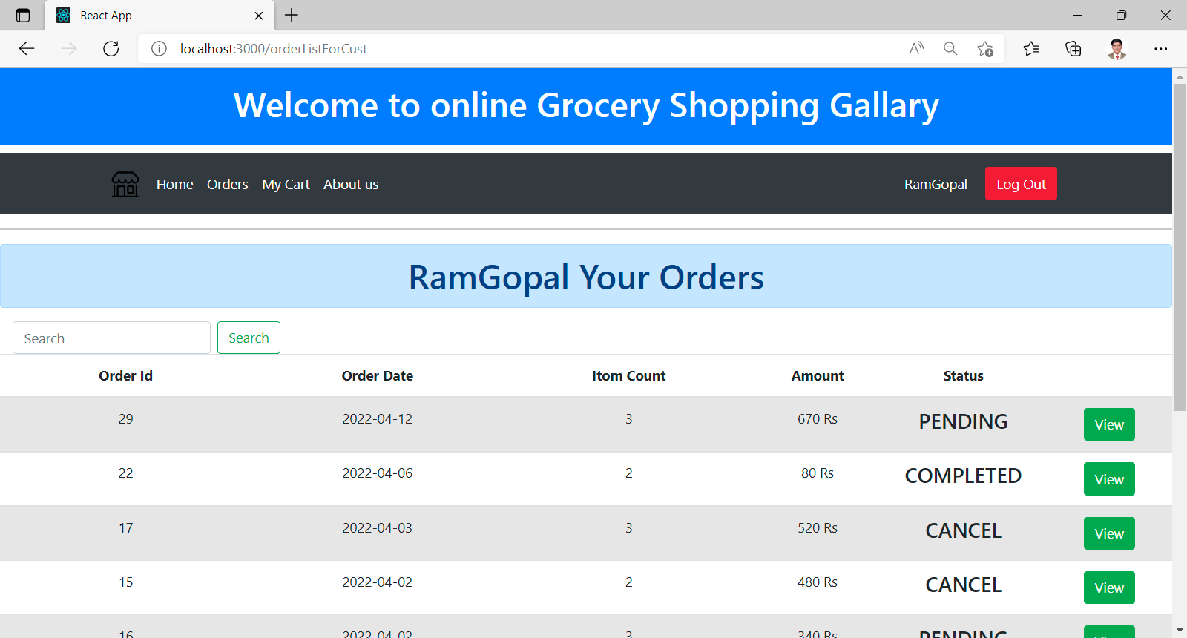
9. After placing order in Orders status is Pending

Slide 25
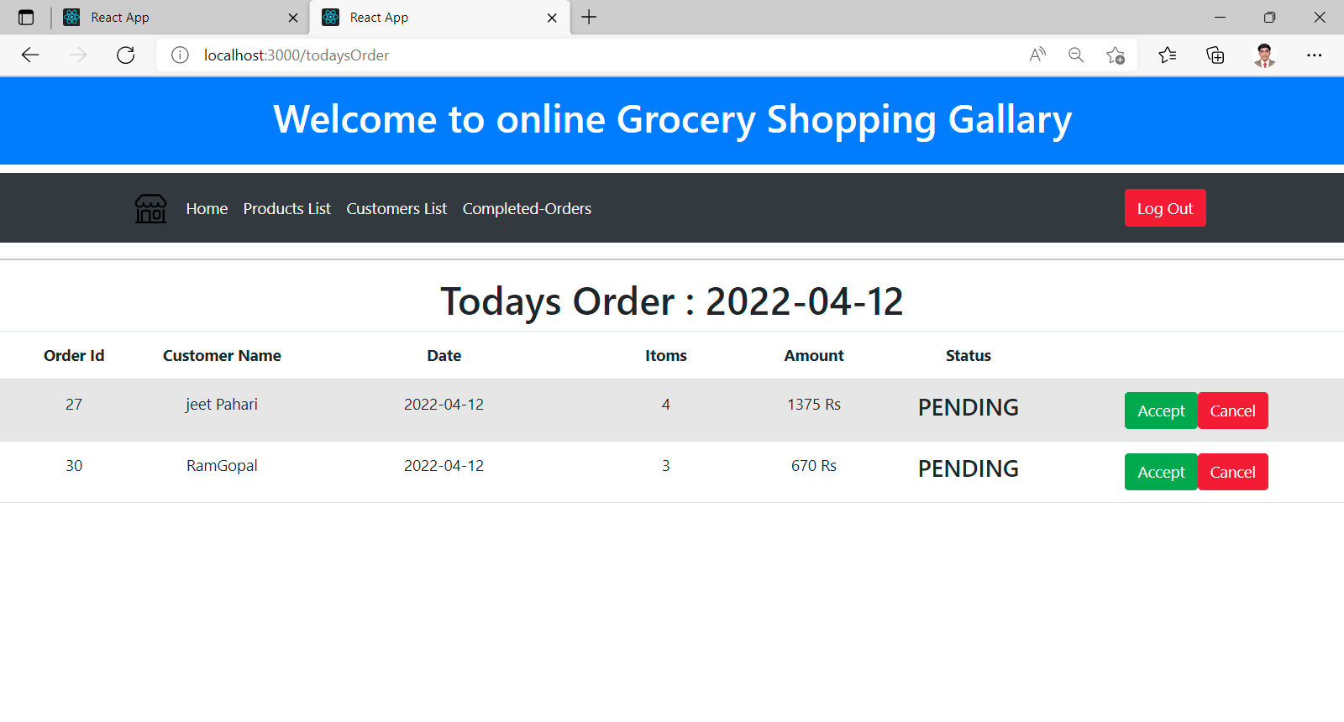
10. Shopkeeper Page (Only show Pending Order or latest order)

Slide 26
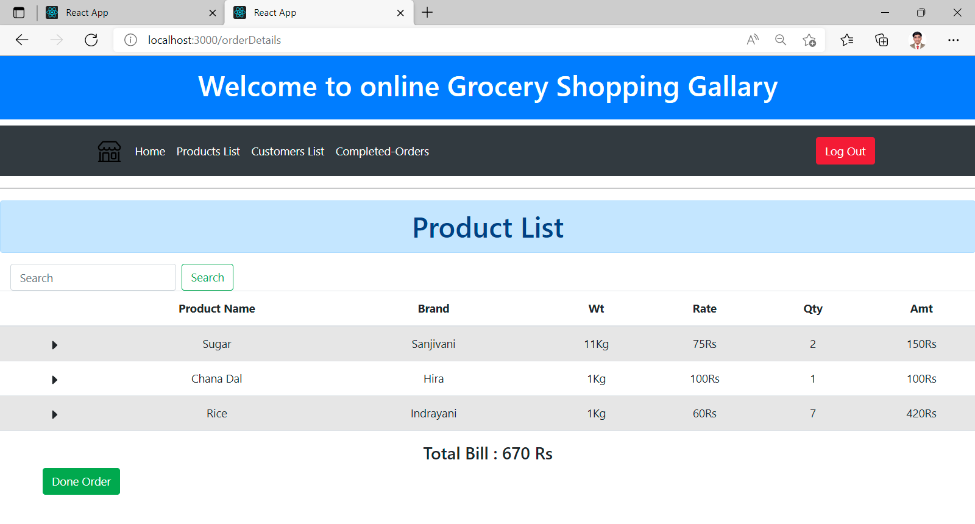
10. On click Accept View Product List

Slide 27
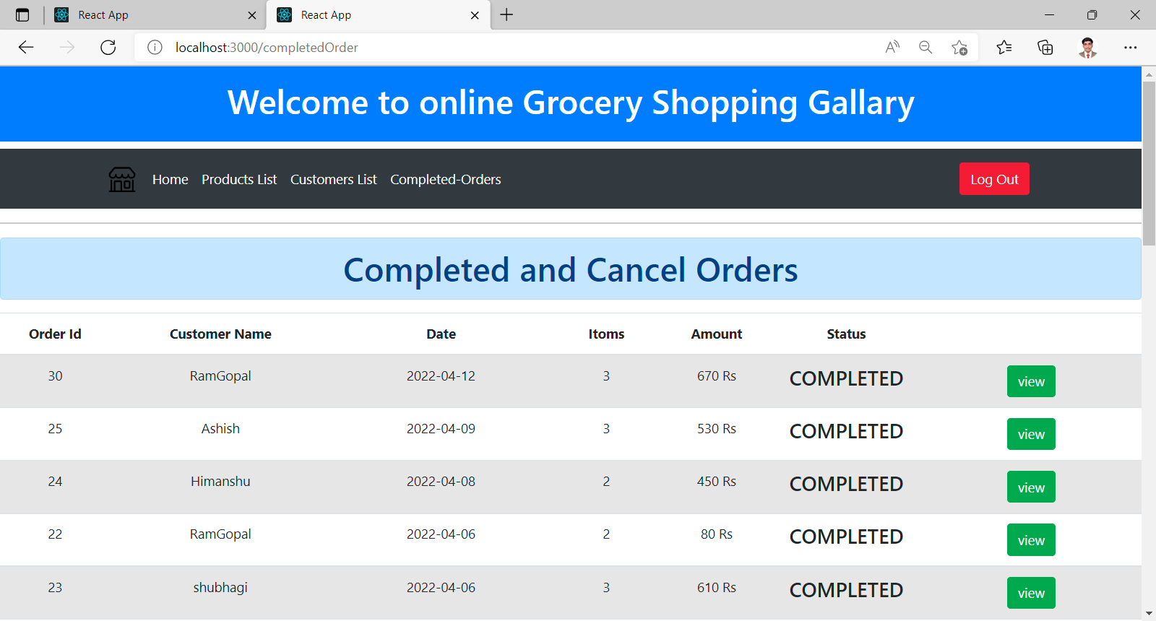
11. On click done Order then Status Will be change to Completed Both side customer And Shopkeeper A. Shopkeeper page All Completed Order

Slide 28
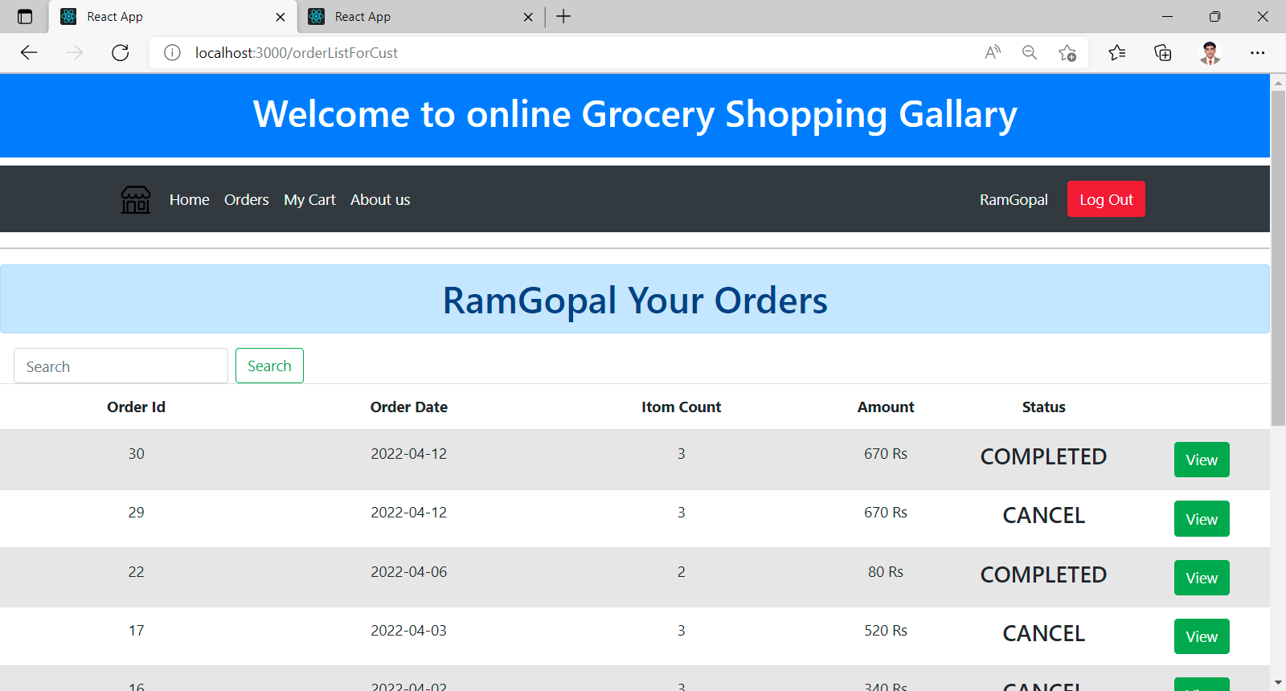
B. Customer Page

Slide 29
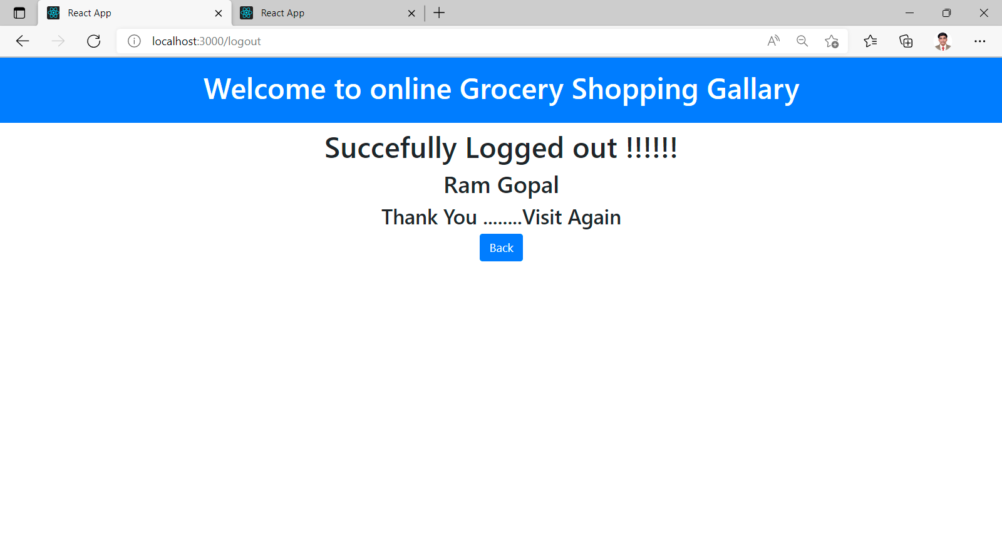
12. Customer Logout

Slide 30
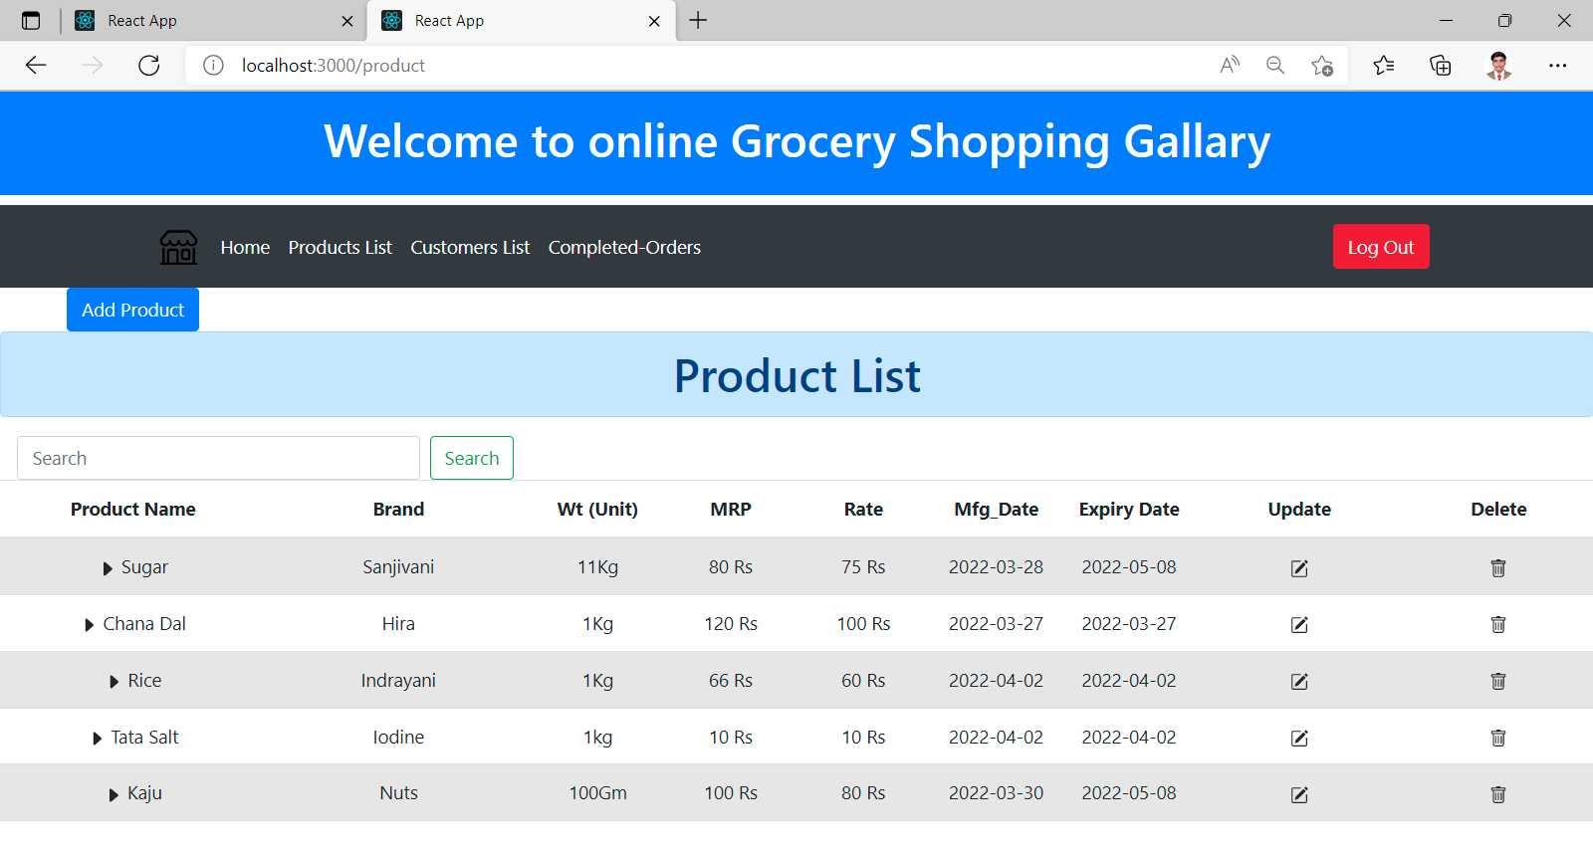
14. All Product (Update Delete Add product)

Slide 31
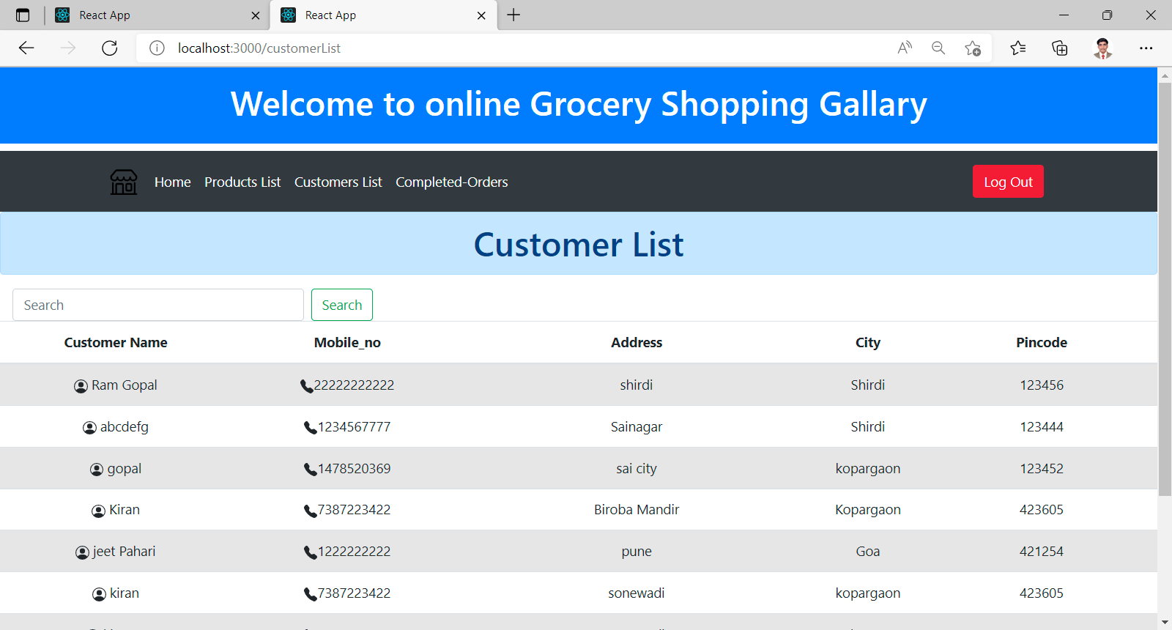
14. All Customer List

Slide 32
Thank you

